Slide 1
Processor Design
5Z032
The role of Performance
Henk Corporaal
Eindhoven University of Technology
2009

Slide 2
Performance
Measure, Report, and Summarize
Make intelligent choices
See through the marketing hype
Key to understanding underlying organizational motivation
Why is some hardware better than others for different programs?
What factors of system performance are hardware related?
(e.g., Do we need a new machine, or a new operating system?)
How does the Instruction Set Architecture (ISA) affect performance?

Slide 3

Which of these airplanes has the best
performance?
Airplane Passengers Range (mi) Speed (mph)
Boeing 737-100 101 630 598
Boeing 747 470 4150 610
BAC/Sud Concorde 132 4000 1350
Douglas DC-8-50 146 8720 544
Which plane is the best?
  which metric do we use?
How much faster is the Concorde compared to the 747?
How much bigger is the 747 than the Douglas DC-8?
Which plane has the best transporting capacity?

Slide 4
Computer Performance:
TIME, TIME, TIME
Response Time, or Latency
— How long does it take for my job to run?
— How long does it take to execute a job?
— How long must I wait for the database query?
Throughput
— How many jobs can the machine run at once?
— What is the average execution rate?
— How much work is getting done?
Q1: If we upgrade a machine with a new processor what do we increase?
Q2: If we add a new machine to the lab what do we increase?

Slide 5
Execution Time
Elapsed Time
  counts everything (disk and memory accesses, I/O , etc.)
  a useful number, but often not good for comparison purposes
CPU time
  doesn't count I/O or time spent running other programs
  can be broken up into system time, and user time
Our focus: user CPU time
  time spent executing the lines of code that are "in" our program

Slide 6
Book's Definition of Performance
For some program running on machine X,
Performance_{X} = 1 / Execution time_{X}
"X is n times faster than Y"
Performance_{X} / Performance_{Y} = n
Problem:
  machine A runs a program in 20 seconds
  machine B runs the same program in 25 seconds
  How much faster is A compared to B?

Slide 7
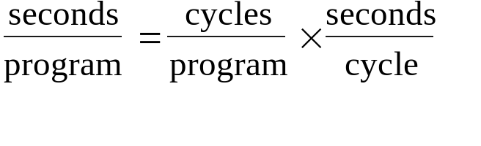
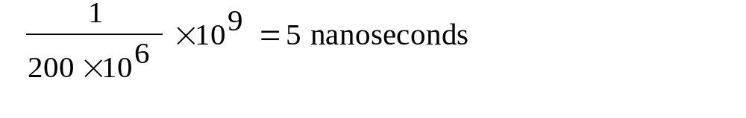
Clock Cycles
Instead of reporting execution time in seconds, we often use cycles
Clock “ticks” indicate when to start activities (one abstraction):
cycle time = time between ticks = seconds per cycle
clock rate (frequency) = cycles per second (1 Hz. = 1 cycle/sec)
A 200 Mhz. clock has a cycle time
cycle
time

Slide 8
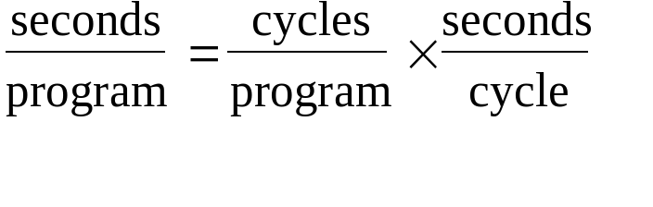
How to Improve Performance
So, to improve performance (everything else being equal) you can either
________ the # of required cycles for a program, or
________ the clock cycle time or, said another way,
________ the clock rate.

Slide 9
How to Improve Performance
Put it another way:
CPU time = N_{cycles} * t_{clock} = N_{cycles} / f_{clock}

Slide 10
How many cycles are required for a program?
Could assume that # of cycles = # of instructions
1st instruction
3rd instruction
2nd instruction
4th
5th
6th
...
time
This assumption is incorrect,
different instructions take different amounts of time on different machines.
Why?

Slide 11
Different numbers of cycles for different instructions
time
Multiplication takes more time than addition
Floating point operations take longer than integer ones
Accessing memory takes more time than accessing registers
Important point: changing the cycle time often changes the number of cycles required for various instructions (more later)

Slide 12
Example
Our favorite program runs in 10 seconds on computer A, which has a 400 Mhz. clock. We are trying to help a computer designer build a new machine B, that will run this program in 6 seconds.
The designer can use new (or perhaps more expensive) technology to substantially increase the clock rate, but has informed us that this increase will affect the rest of the CPU design, causing machine B to require 1.2 times as many clock cycles as machine A for the same program.
What clock rate should we tell the designer to target?"
(Don't Panic, you can easily work this out from basic principles !!)

Slide 13
Now that we understand cycles
A given program will require
  some number of instructions (machine instructions)
  some number of cycles
  some number of seconds
We have a vocabulary that relates these quantities:
  cycle time (seconds per cycle)
  clock rate (cycles per second)
  CPI (cycles per instruction)
  a floating point intensive application might have a higher CPI
  MIPS (millions of instructions per second)
  this would be higher for a program using simple instructions

Slide 14
Performance
Performance is determined by execution time
Do any of the other variables equal performance?
  # of cycles to execute program?
  # of instructions in program?
  # of cycles per second?
  average # of cycles per instruction?
  average # of instructions per second?
Common pitfall: thinking one of the variables is indicative of performance when it really isn’t.

Slide 15
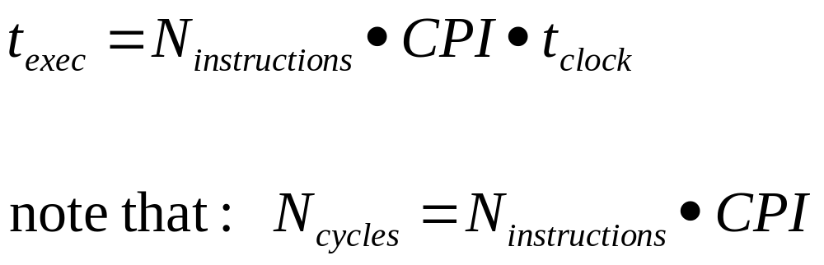
Performance
Famous equation:

Slide 16
CPI Example
Suppose we have two implementations of the same instruction set architecture (ISA).
For some program,
Machine A has a clock cycle time of 10 ns. and a CPI of 2.0
Machine B has a clock cycle time of 20 ns. and a CPI of 1.2
What machine is faster for this program, and by how much?
If two machines have the same ISA which of our quantities (e.g., clock rate, CPI, execution time, # of instructions, MIPS) will always be identical?

Slide 17
# of Instructions Example
A compiler designer is trying to decide between two code sequences for a particular machine. Based on the hardware implementation, there are three different classes of instructions: Class A, Class B, and Class C, and they require one, two, and three cycles (respectively).
The first code sequence has 5 instructions:
2 of A, 1 of B, and 2 of C
The second sequence has 6 instructions:
4 of A, 1 of B, and 1 of C.
Which sequence will be faster? How much?
What is the CPI for each sequence?

Slide 18
MIPS example
Two different compilers are being tested for a 100 MHz. machine with three different classes of instructions: Class A, Class B, and Class C, which require one, two, and three cycles (respectively). Both compilers are used to produce code for a large piece of software.
The first compiler's code uses 5 million Class A instructions, 1 million Class B instructions, and 1 million Class C instructions.
The second compiler's code uses 10 million Class A instructions, 1 million Class B instructions, and 1 million Class C instructions.
Which sequence will be faster according to MIPS?
Which sequence will be faster according to execution time?

Slide 19
Benchmarks
Performance best determined by running a real application
  Use programs typical of expected workload
  Or, typical of expected class of applications
  e.g., compilers/editors, scientific applications, graphics, etc.
Small benchmarks
  nice for architects and designers
  easy to standardize
  can be abused
SPEC (System Performance Evaluation Cooperative)
  companies have agreed on a set of real program and inputs
  can still be abused (Intel’s “other” bug)
  valuable indicator of performance (and compiler technology)

Slide 20
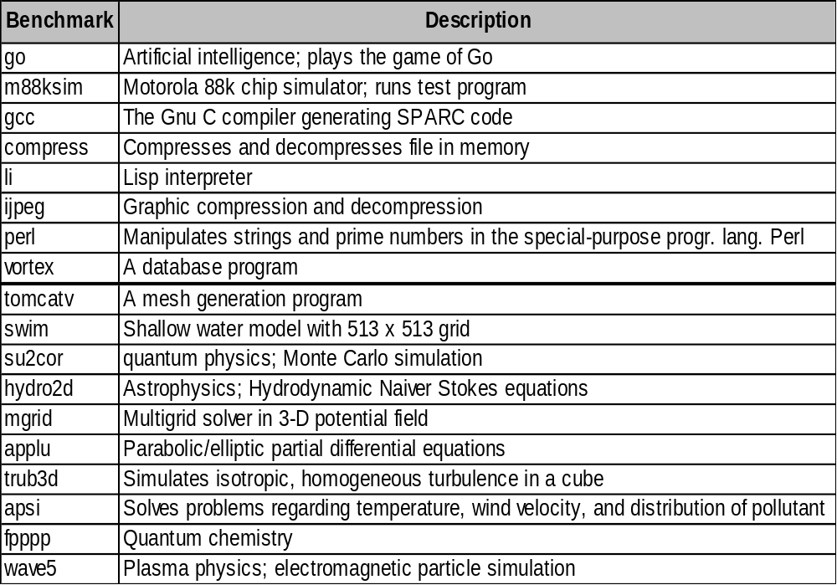
SPEC ‘95
C
Fortran

Slide 21
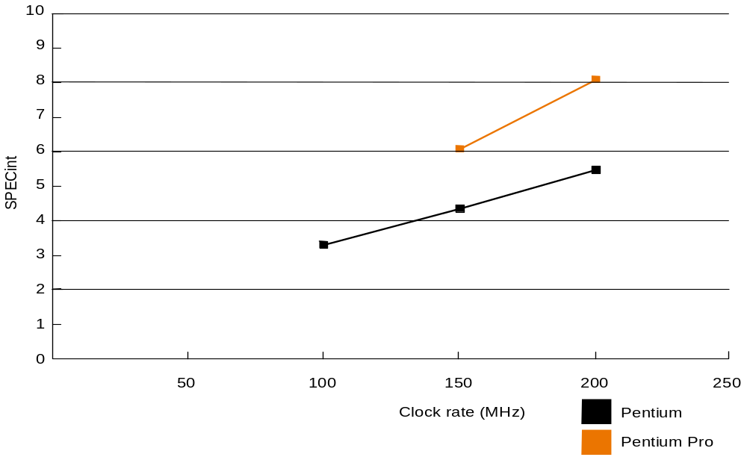
SPEC ‘95 Integer
Does doubling the clock rate double the performance?
Can a machine with a slower clock rate have better performance?

Slide 22
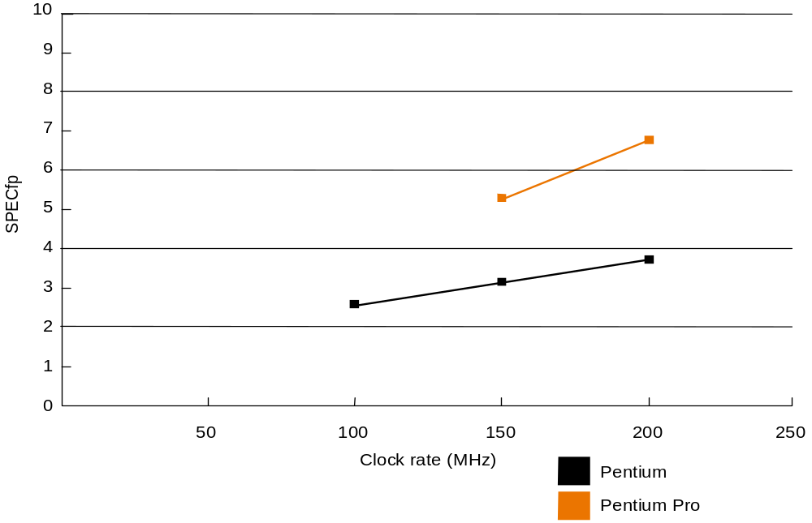
SPEC`95: FP

Slide 23
Amdahl's Law
Execution Time After Improvement =
Execution Time Unaffected +( Execution Time Affected / Amount of Improvement )
Example:
"Suppose a program runs in 100 seconds on a machine, with the multiply operation responsible for 80 seconds of this time. How much do we have to improve the speed of multiplication if we want the program to run 4 times faster?"
How about making it 5 times faster?
Principle: Make the common case fast

Slide 24
Examples
Suppose we enhance a machine making all floating-point instructions run five times faster. If the execution time of some benchmark before the floating-point enhancement is 10 seconds, what will the speedup be if half of the 10 seconds is spent executing floating-point instructions?
We are looking for a benchmark to show off the new floating-point unit described above, and want the overall benchmark to show a speedup of 3. One benchmark we are considering runs for 100 seconds with the old floating-point hardware. How much of the execution time would floating-point instructions have to account for in this program in order to yield our desired speedup on this benchmark?

Slide 25
Remember
Performance is specific to a particular program (and its data set)
  Total execution time is a consistent summary of performance
For a given architecture performance increases come from:
  increases in clock rate (without adverse CPI affects)
  improvements in processor organization that lower CPI
  compiler enhancements that lower CPI and/or instruction count
Pitfall: expecting improvement in one aspect of a machine’s performance to affect the total performance
You should not always believe everything you read! Read carefully!
(see newspaper articles, e.g., Exercise 2.37)

Slide 26
Review: Aspects of CPU Performance
CPU time = Seconds = Instructions x Cycles x Seconds
Program Program Instruction Cycle
instr count CPI clock rate
Program X
Compiler X X
Instr. Set X X
Organization X X
Technology X

Slide 27
Exercises
From Chapter two (2nd ed.):
2.1, 2.2, 2.5, 2.8
2.10 - 2.13
2.18 - 2.24

